Slide 1







Programming Language and their Future
Harshal.u.
06/12/2020

Slide 2



OUTLINE
Executive Summary
Introduction
Methodology
Results
Visualization – Charts
Dashboard
Discussion
Findings & Implications
Conclusion
Appendix

Slide 3

EXECUTIVE SUMMARY
Programming Languages Currently Used.
Gender data according to the surveys :-
No of males have more and variety of education in the sector.
Few Females have taken the survey.
Encourage female employment.
Programming Languages and its future.
Age Group currently in sectors.
Percentage of gender in sectors as a whole.
Trends over the world according to the survey.

Slide 4

INTRODUCTION
Analysis is done to determine the rising trends.
To determine which skillset will help a person in the coming future.
People working in multiple sectors ,their education and age.
Problem:-
Less percentage of educated female employed in the current sectors.
Most Prog Lang which are in current trend are becoming obsolete.
No of educated females are less compared to males.

Slide 5

METHODOLOGY
Data is sourced from multiple sites.
Data is collected to find the rising and current trend.
Find the percentage of Male and Female.
Age groups in the current sector.
Data Source:-
www.kaggle.com
Online SURVEY

Slide 6
RESULTS
According to the data findings we have figured out which are the upcoming languages that will be beneficial to learn when opting for a job interview and which might give you the edge over the others.
The data also gives us the percentage of woman working in the sectors who taken part in the survey , this tells us that the percentage of men working or having knowledge regarding languages/education is huge when compared to women.
It also tells us the age group ,who are currently working in these sectors.
Data findings is derived from surveys and online websites which are filled/got through out the world.

Slide 7
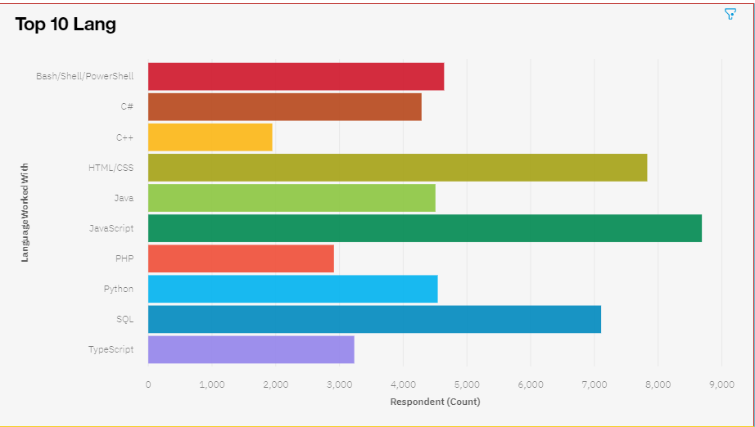
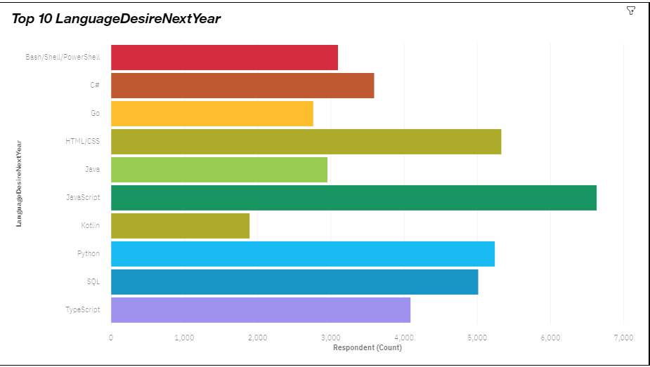
PROGRAMMING LANGUAGE TRENDS
Current Year
Next Year

Slide 8
PROGRAMMING LANGUAGE TRENDS - FINDINGS & IMPLICATIONS
Findings
JavaScript is still the no 1 prog lang.
Python and TypeScript are in a rising demand.
Some lang such as PHP and C++ have become obsolete.
Implications
JavaScript is 1 of the best skill sets to have.
Python and TypeScript can help in the upcoming future ,so learning/picking these skill sets up along is a must.
New lang have taken there places such as GO and KOTIN.

Slide 9
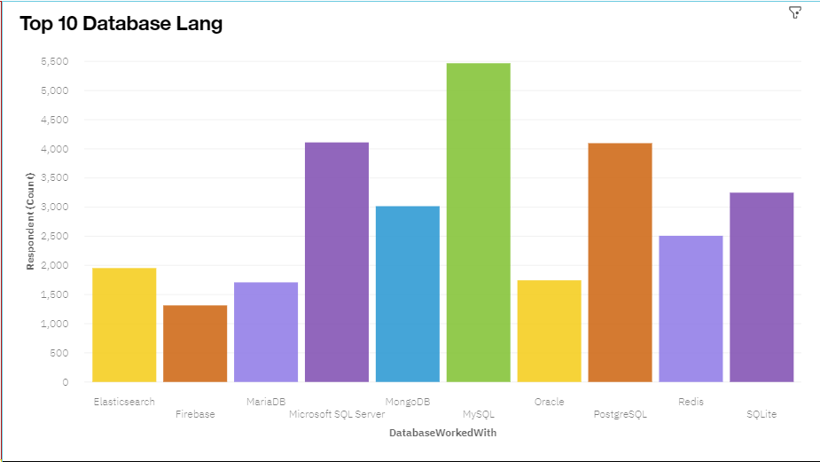
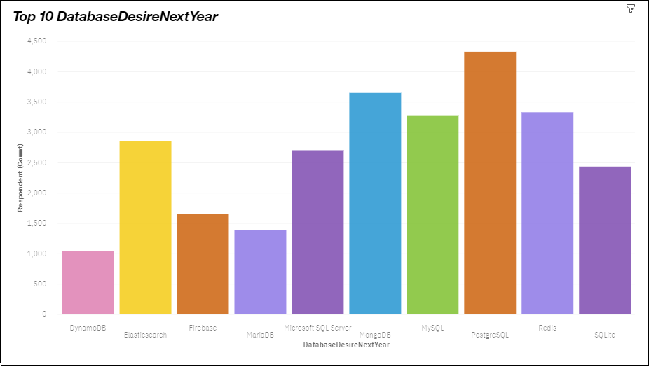
DATABASE TRENDS
Current Year
Next Year

Slide 10
DATABASE TRENDS - FINDINGS & IMPLICATIONS
Findings
MySql is not the best database lang anymore.
MangoDb is 1 of the best database lang .
Most lang have become obsolete.
Implications
PostgreSql is the best upcoming database lang out there.
MangoDb skillset is a must.
Time to learn new lang.

Slide 11

DASHBOARD
Online Dashboard Hyperlink

Slide 12
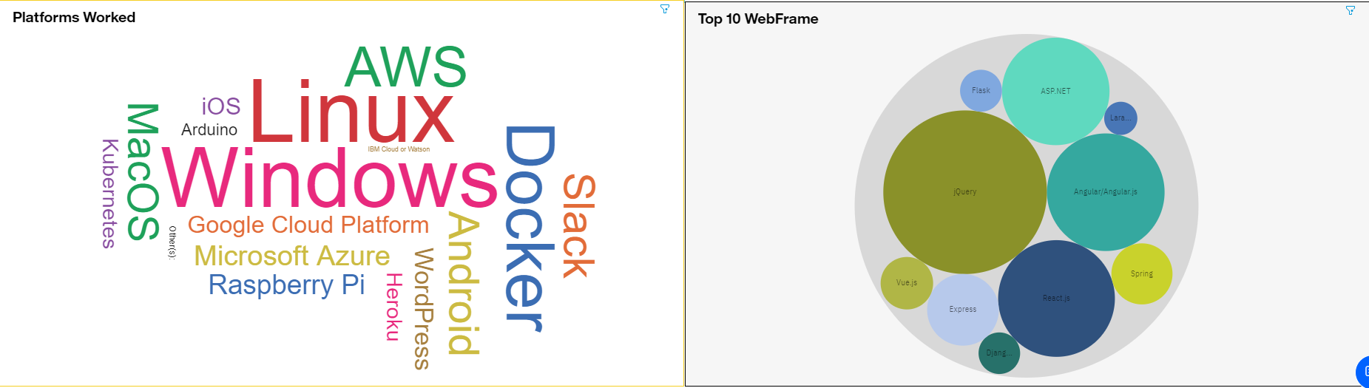
DASHBOARD TAB 1

Slide 13
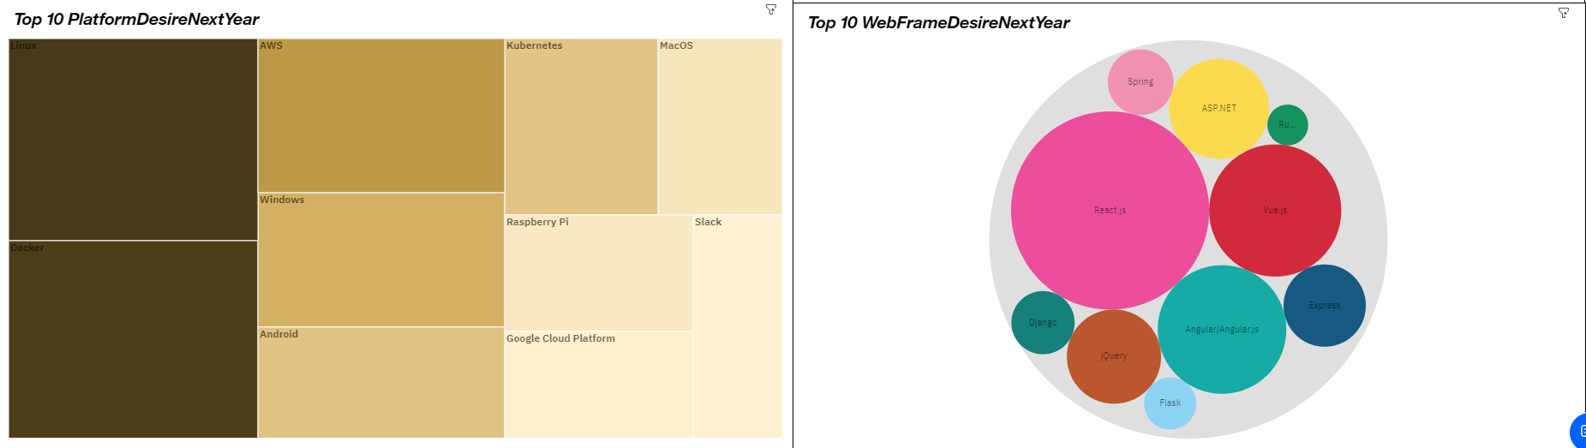
DASHBOARD TAB 2

Slide 14
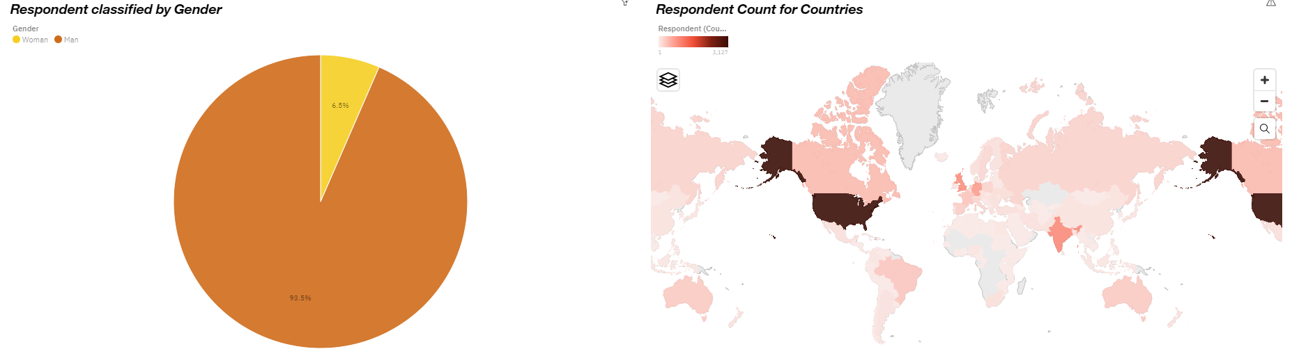
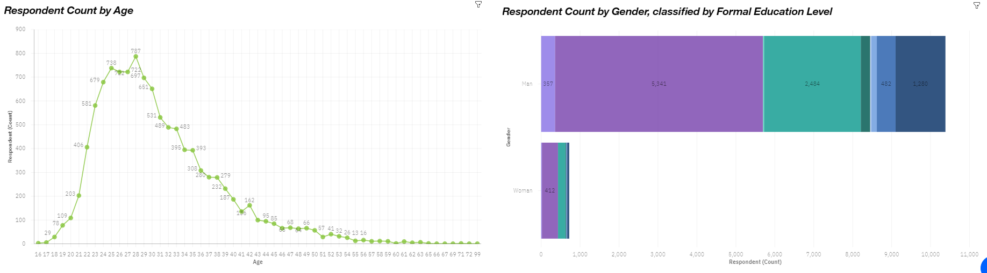
DASHBOARD TAB 3

Slide 15
DISCUSSION
According to the data findings which prog lang are you going to opt for and why?
According to the data findings which database lang are you going to opt for and why?
Does gender matter?
What do you think we can do in order to increase the percentage of woman in these sectors?
Did these data finding help you in any way to make a clear decisions?

Slide 16
OVERALL FINDINGS & IMPLICATIONS
Findings
Some prog lang have become obsolete.
Most database lang have become obsolete.
Percentage of men is higher compared to women in most sectors.
Age group around 21-39 have the highest count to have responded to the survey and are working.
Implications
Time to pick up new skill sets or get up-to-date with the rising trend of prog languages.
Time to pick up new skill sets or get up-to-date with the rising trend of database languages.
Encourage women to apply for jobs and get better education.

Slide 17

CONCLUSION
JavaScript is still the best prog language with Python and TypeScript coming in 2nd and 3rd.
MySql has become obsolete and its place has been taken by PostgreSql as the No.1 database lang, while MangoDb is close behind being 2nd.
Percentage of men is higher compared to women in most sectors. So, Encourage women to apply for jobs and get better education.
21-39 is the highest working age-group.

Slide 18
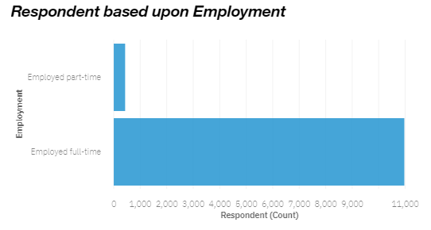

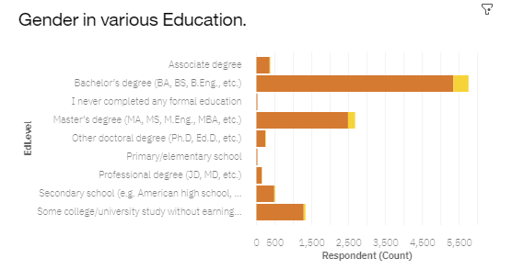
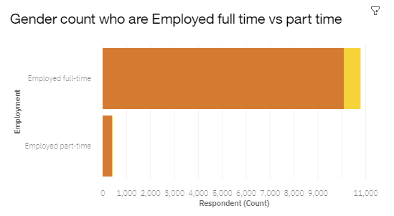
APPENDIX
Most Responders have a full-time job.
Less women in various educational levels.
Men have a majority of jobs in both full-time and part-time.

Slide 19
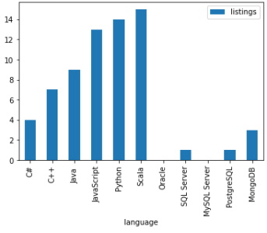
GITHUB JOB POSTINGS
List of jobs depending on languages.

